Slide 1

Sales Status Analysis
Submitted By,
Mohamed Rashid M

Slide 2
CONTENT
Overview
Dataset Description
CRISP-DM
Modules
Conclusion

Slide 3
Overview
Sales status analysis is Classification of variety of products into different status category
Status has different category. So classifying the products into these category is sales status analysis
To execute we have to create two models using ( algorithm names) and we will proceeding with the better model For further processes.

Slide 4
Dataset Description:
The dataset used in this project is the Amazon Sales data from Kaggle.
Dataset Name: Amazon_Sales_Dataset.csv.
It comprises 115857 observations and 22 variables.
This dataset provides detailed insights into Amazon sales data to help optimize product profitability.

Slide 5
Dataset Features Information:
Order ID:
Date: Date of the sale. (Date)
Status: Status of the sale. (String)
Fulfilment: Method of fulfilment. (String)
Ship-service-level:
Style: Style of the product. (String)
SKU: Stock Keeping Unit. (String)
Category: Type of product. (String)
ASIN: Amazon Standard Identification Number. (String)

Slide 6
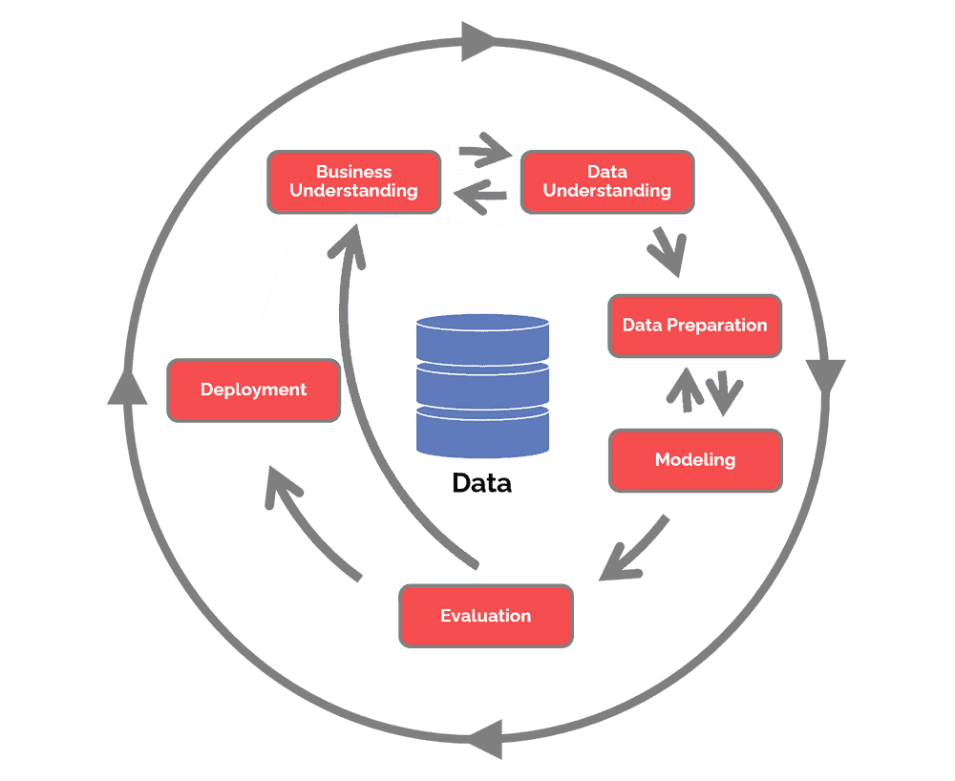
CRISP-DM
The Cross Industry Standard Process for Data Mining (CRISP-DM) is a process model that serves as the base for a data science process. It has six sequential phases:
1.Business understanding – What does the business need?
2.Data understanding – What data do we have / need? Is it clean?
3.Data preparation – How do we organize the data for modeling?
4.Modeling – What modeling techniques should we apply?
5.Evaluation – Which model best meets the business objectives?
6.Deployment – How do stakeholders access the results?

Slide 7
Modules
All Phases of CRISP_DM
Data Visualization
Conclusion

Slide 8
1. Business Understanding
Analyzing and Maximizing Online Business Performance.
2. Data understanding
Collect initial data
Describe data
Explore data
Verify data quality

Slide 9
3. Data preparation
This phase prepares the final data set(s) for modeling.
The categorical variables Category, Qty, Courier Status, ship-service-level, Fulfilment are converted into numerical variables
To standardized features to the same scale , categorical variables will be changed into numerical variables.
This will help for the better analysis
4. Modeling
The target variable is Status and Input variables are Category, Qty, Courier Status, ship-service-level, Fulfilment.
Three different models are created
First one is created with Decision Tree Classifier algorithm
Second one is created with Random Forest Classifier algorithm
Second one is created with Support Vector Machine algorithm.

Slide 10
Decision Tree Classifier
A decision tree classifier is a supervised machine learning algorithm that is used for classification problems.
It works by splitting a dataset into subsets based on different conditions.
The classifier then uses a tree-like structure to identify the most important features of the data and assign labels as the output.
The accuracy is 96.741767%

Slide 11
Random Forest Classifier
Random Forest is an ensemble machine learning algorithm. It is a type of supervised learning algorithm that is mostly used for classification problems.
It works by creating multiple decision trees. which are decision models that allow computers to make predictions and then combining their output to make a more accurate prediction.
This helps to reduce the variance and bias in the model, resulting in a more accurate prediction.
The accuracy is 96.7461005%

Slide 12
Support Vector Machine
Support Vector Machines (SVMs) are a type of supervised machine learning algorithm that can be used for both classification and regression tasks.
The goal of an SVM is to identify the optimal hyperplane that maximizes the margin between the closest data points of different classes.
This hyperplane is then used to classify new data points. To find the optimal hyperplane, the SVM algorithm uses a set of mathematical functions that are defined based on the data.
These functions help to categorize the data, so that the data points of one class are separated from the data points of the other class.
The accuracy is 96.75476%

Slide 13
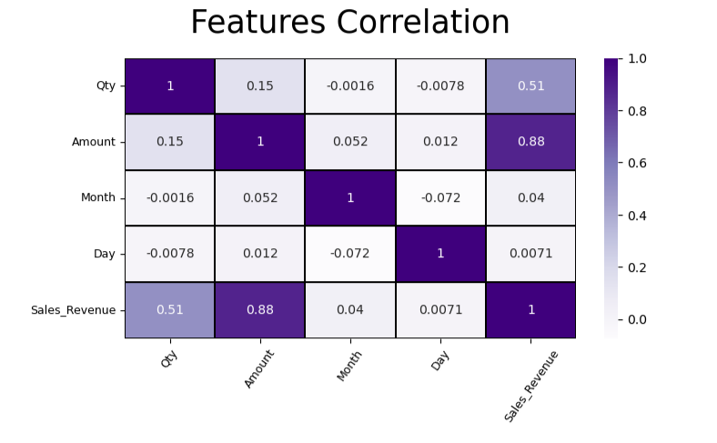
Evaluation

Slide 14
Deployment
The deployment phase requires the consequences of the evaluation to verify a strategy for deployment within a particular company.
When the results of the project will be used widely, it is significant that the business should take required actions to use definitely the models.
At this phase, final report and presentation of the found results are produced.

Slide 15
Conclusion
From this we get to know the Support Vector Machine algorithm would be a better model as it has higher accuracy
That model can be used for further process like validation and future forecast
From the visualization we get to know the relationship between the variables.

